Slide 1
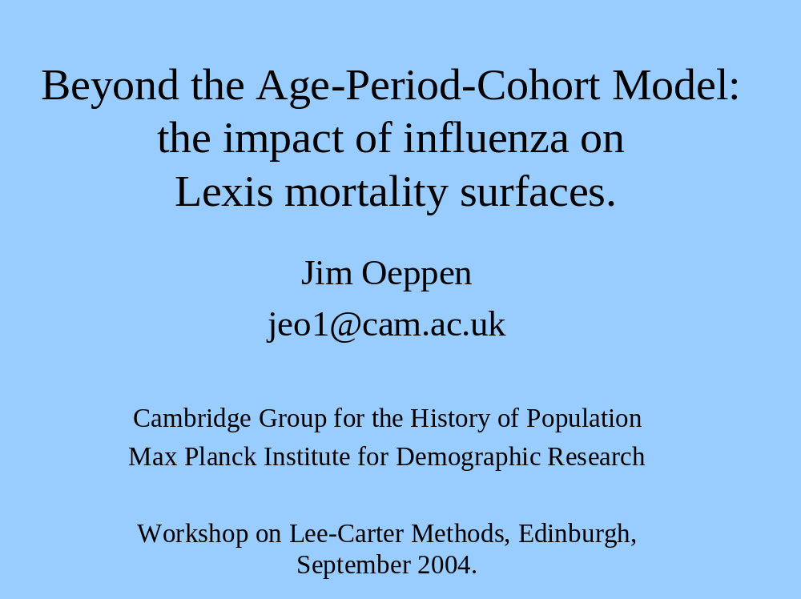

Slide 2
Influenza Virus
Haemagglutinin
HA
H1
N1
Neuraminidase
NA
Viral RNA:
8 genes
Redrawn from Collier and Oxford (1993)

Slide 3
Antigenic Shift: gene reassortment
H1N1
H2N2
Cell
Redrawn from Collier and Oxford (1993)

Slide 4
Antigenic Shift: gene reassortment
e.g. H1N1 replaced by H2N2
Antigenic Drift: minor mutatations
progressive and cumulative
e.g. A/Wuhan/359/1995 (H3N2)
to A/Sydney/5/1997 (H3N2)

Slide 5
Age Effects and Influenza
1) No “input side” hypotheses.
2) “Response” side hypotheses:
a) “Frailty” rises with age, and other medical conditions.
b) Intrinsic immunity from mother? (under 6 months?).

Slide 6
Age-Specific Response to
Antigenic Shift in Influenza
Relative Mortality Risk
1.0
Age
0

Slide 7
Period Effects and Influenza
1) Antigenic-Drift produces new variants
2) Antigenic-Shift produces new Sub-Types
3) The new Sub-Type eliminates the old one.
4) Immunity is Specific to an Influenza Sub-Type.
5) Virus re-cycling.

Slide 8
Table of shifts.
Identify laboratory versus sero-archaeology

Slide 9
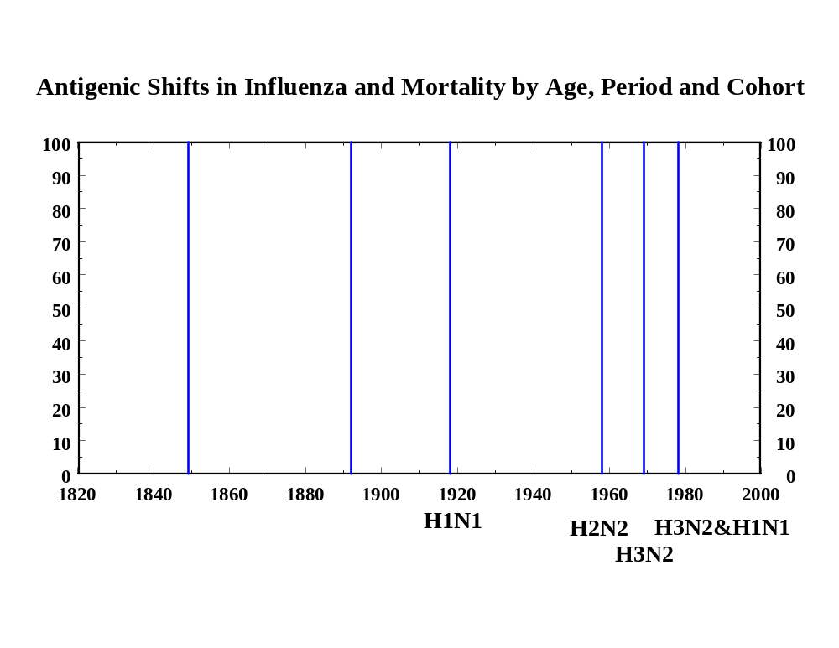

Slide 10
Cohort Effects and Influenza
1) “Original Antigenic Sin”
2) Debility and Selection
Complications: Pregnancy
Cardiovascular
Respiratory
Neurological

Slide 11
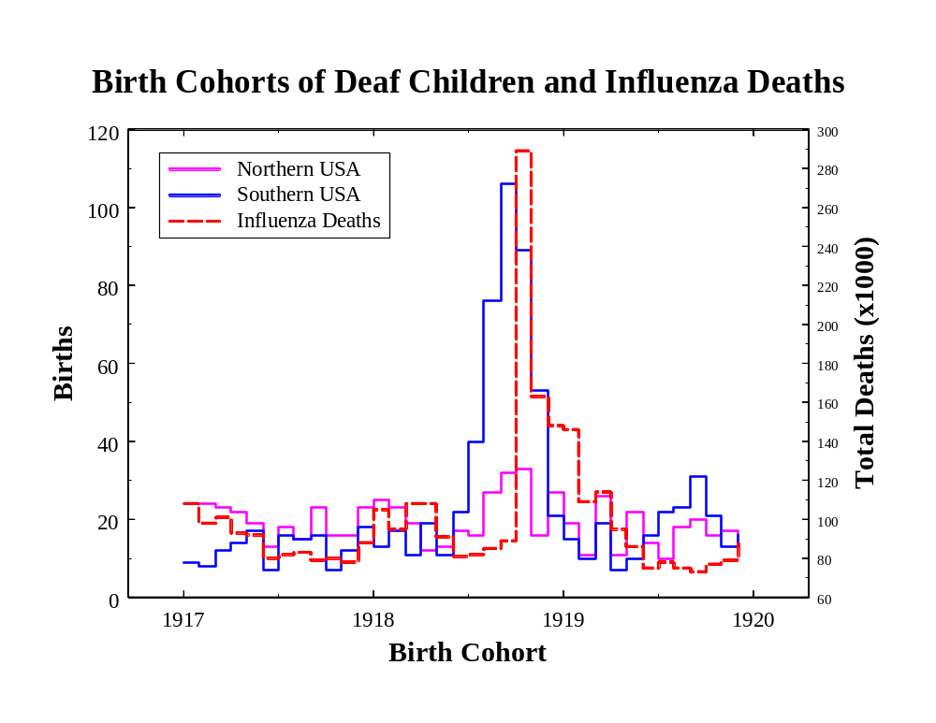

Slide 12
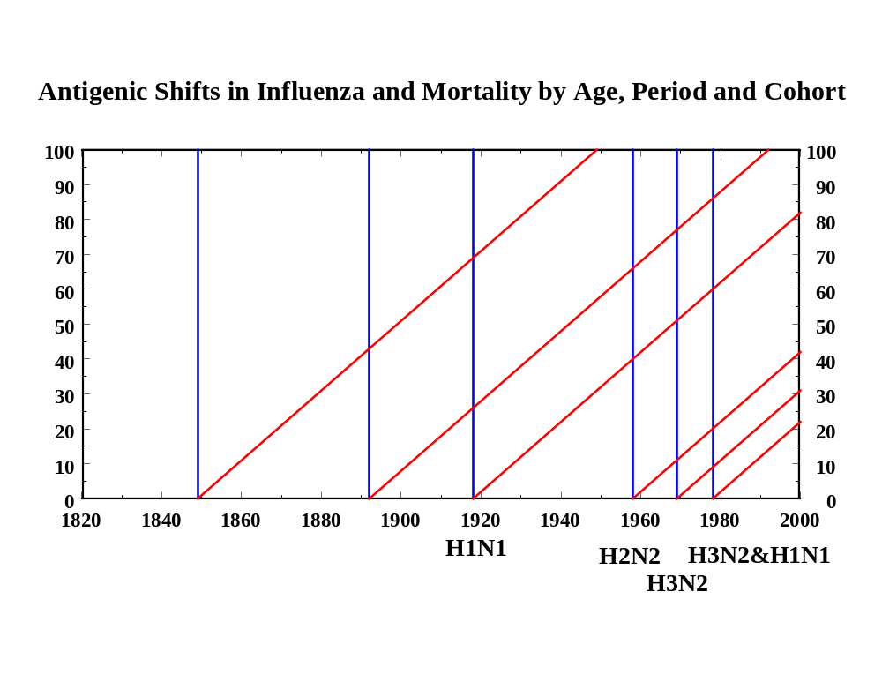

Slide 13
Mortality Surface
APC model: Age-Period-Cohort
100
Age
0
1841
Cohorts
Period
2000
Age = Period - Cohort

Slide 14
Excess Mortality Ratio
Epidemic:
Period Effect
100
Age
2.6
0
1841
2.6
1880
Birth Cohort
2000
“Normal Years”

Slide 15
Cohort-Period Interaction Effects
Antigenic Shift
Epidemic
Excess
Mortality
Ratio
1.0
1848
1891
1918
H?
??
H1

Slide 16
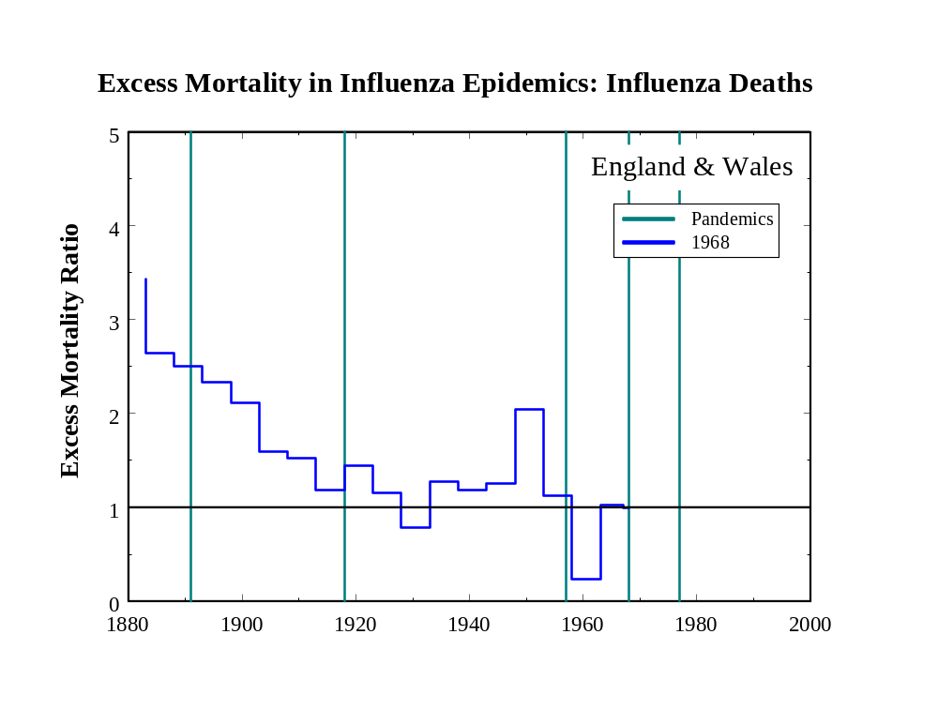

Slide 17
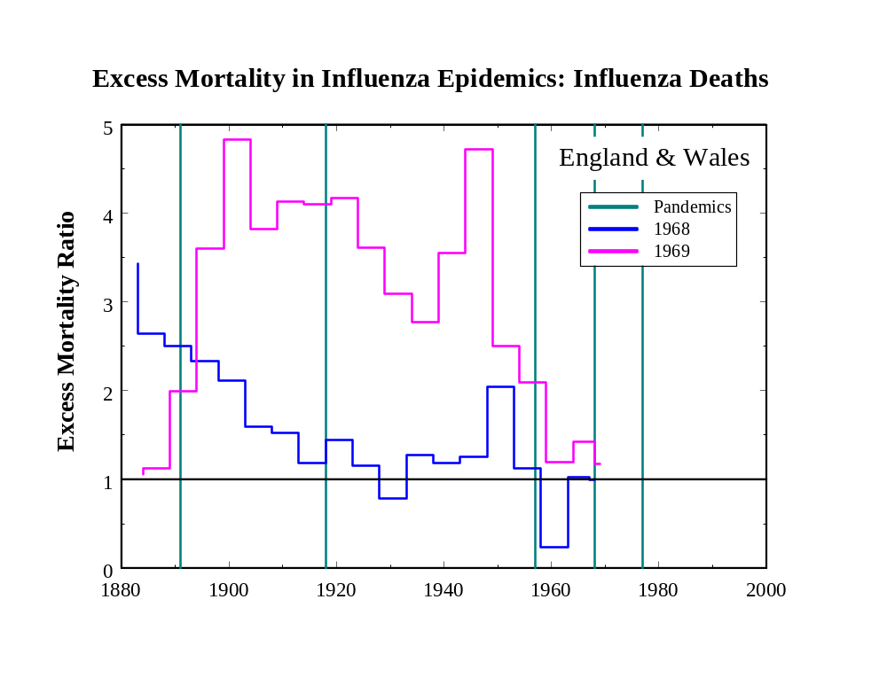

Slide 18
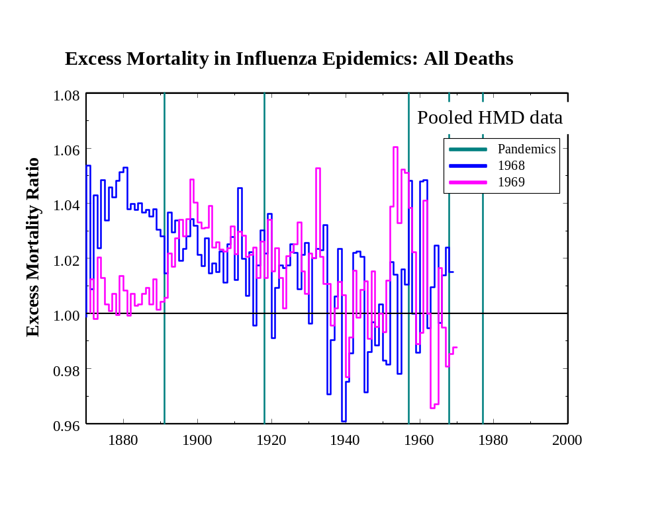

Slide 19
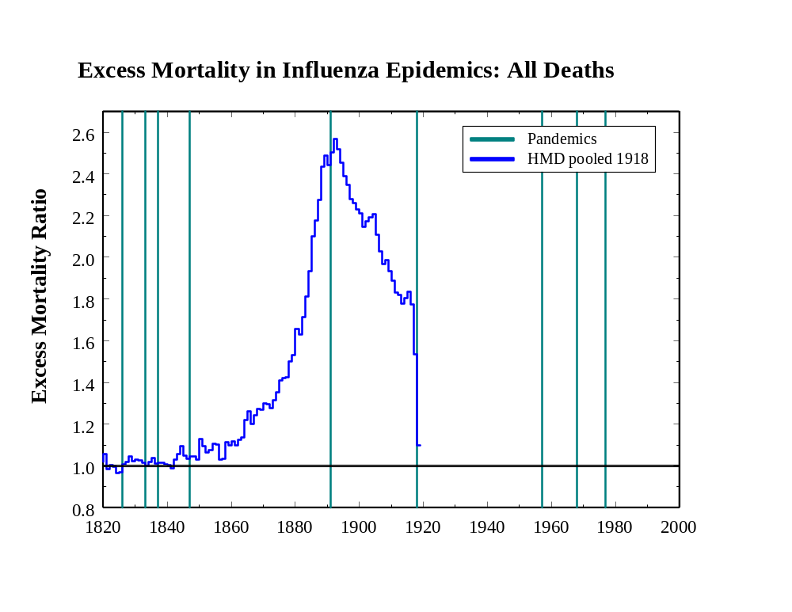

Slide 20
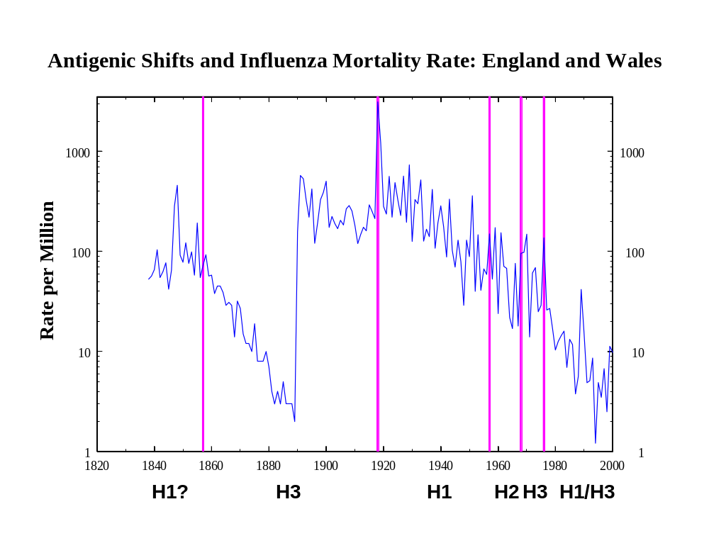

Slide 21
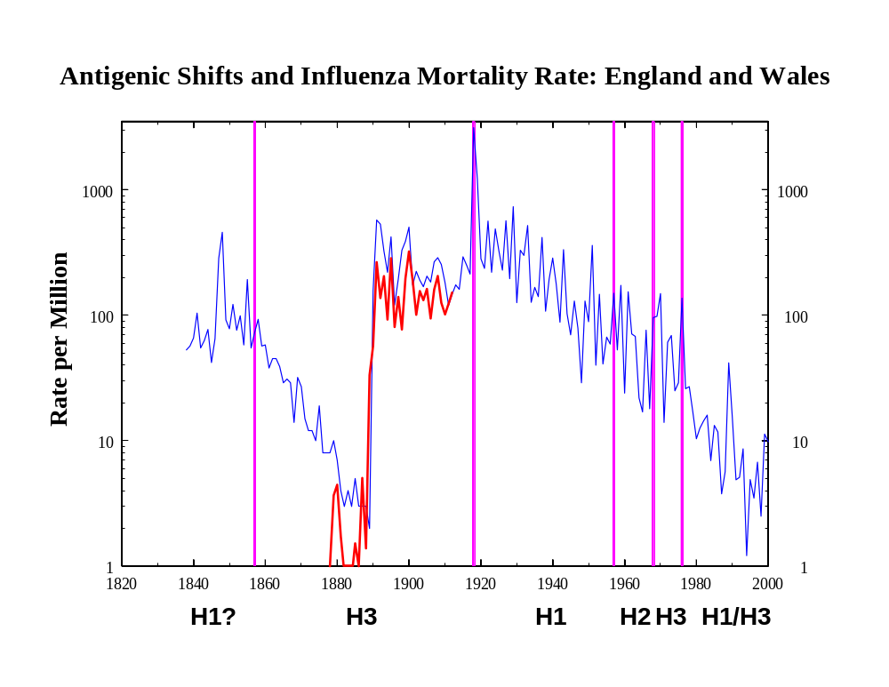
Berlin

Slide 22
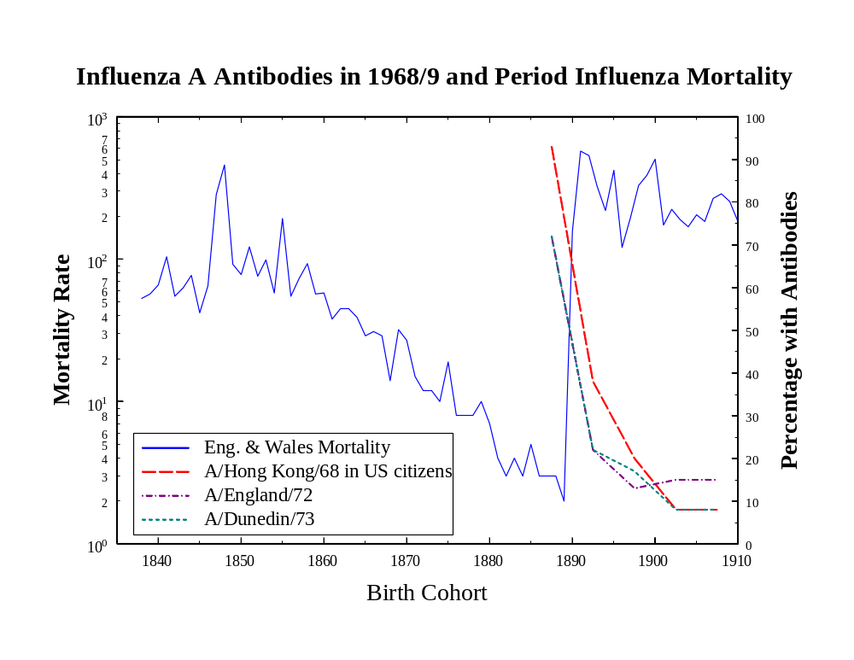

Slide 23
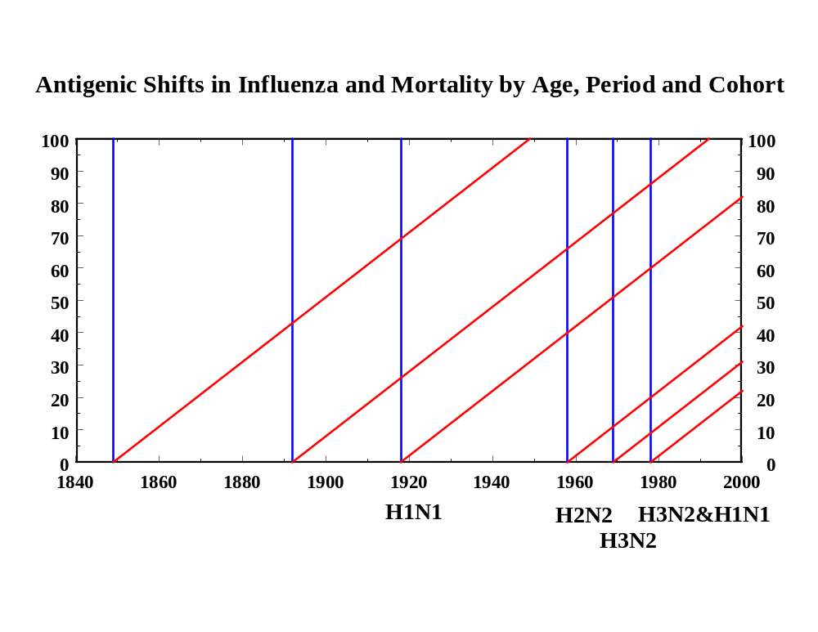
H3, H1
H3, H3
H1, H1
H1?
H3?
Log(mortality) = f(Age, Period, Cohort, HN(Cohort)*HN(Period))

Slide 24
APC Model: Sweden + England & Wales: Type III SS
Factor F P-value
Age x Country 2557 <.0001
Period x Country 173 <.0001
Cohort x Country 235 <.0001
Factor F P-value
Age x Country 1937 <.0001
Period x Country 76 <.0001
Cohort x Country 63 <.0001
HN(cohort) x HN(period) 220 <.0001

Slide 25
